Slide 1

MIME 3450: Energy Lab Lab 5B: ML and Matlab Based Heat Exchanger (Python TensorFlow & MATLAB Implementation)

Slide 2
Introduction
Objective: Apply a basic machine learning (ML) model to predict the overall heat transfer coefficient of shell-and-tube heat exchangers using data collected from your heat exchanger experiment. This exercise introduces students to the concept of data-driven modeling in engineering, helps reinforce the physical meaning of measured variables, and demonstrates how ML can be used to estimate properties that are otherwise difficult to measure directly.
Background: Engineers often use mathematical models and physical laws to predict system behavior. Increasingly, data-driven tools like machine learning allow us to "learn" complex relationships between inputs and outputs from experimental data. In thermal engineering, ML can help predict properties (like overall heat transfer coefficient, U) when direct measurement is impractical. This lab builds on your heat exchanger experiment. You will organize your data, prepare it for ML usingTensorFlow or MATLAB, and interpret the output of a simple neural network model.
Machine Learning is a method of teaching computers to recognize patterns in data and make predictions without being explicitly programmed for every step. In supervised learning, we provide examples of "features" (measured or calculated values, like inlet/outlet temperatures and flow rates) and "labels" (the output we'd like to predict, like overall heat transfer coefficient).

Slide 3
Tool Description
TensorFlow and MATLAB ML Toolbox
Extensive community support Built-in GUI for model training
Detailed control over model architecture Automated hyperparameter tuning
Excellent visualization capabilities Integrated with MATLAB ecosystem
Advanced ML techniques available One-click neural network training

Slide 4

Let’s Break It Down
Feature: An input variable to ML model (inlet/outlet temperatures, flow rates, fluid densities).
Label/Target: The output the model predicts (overall heat transfer coefficient U).
Training Set: Data used to teach the model heat exchanger relationships.
Testing Set: Data used to evaluate performance on unseen operating conditions.
Epoch: One complete training cycle through all heat exchanger data.
Loss Function: Measure of how wrong predictions are (Mean Squared Error for heat transfer coefficient).
Optimizer: Algorithm that updates the model (Adam optimizer for neural networks).
Activation Function: Introduces non-linearity to help model learn complex heat transfer patterns

Slide 5
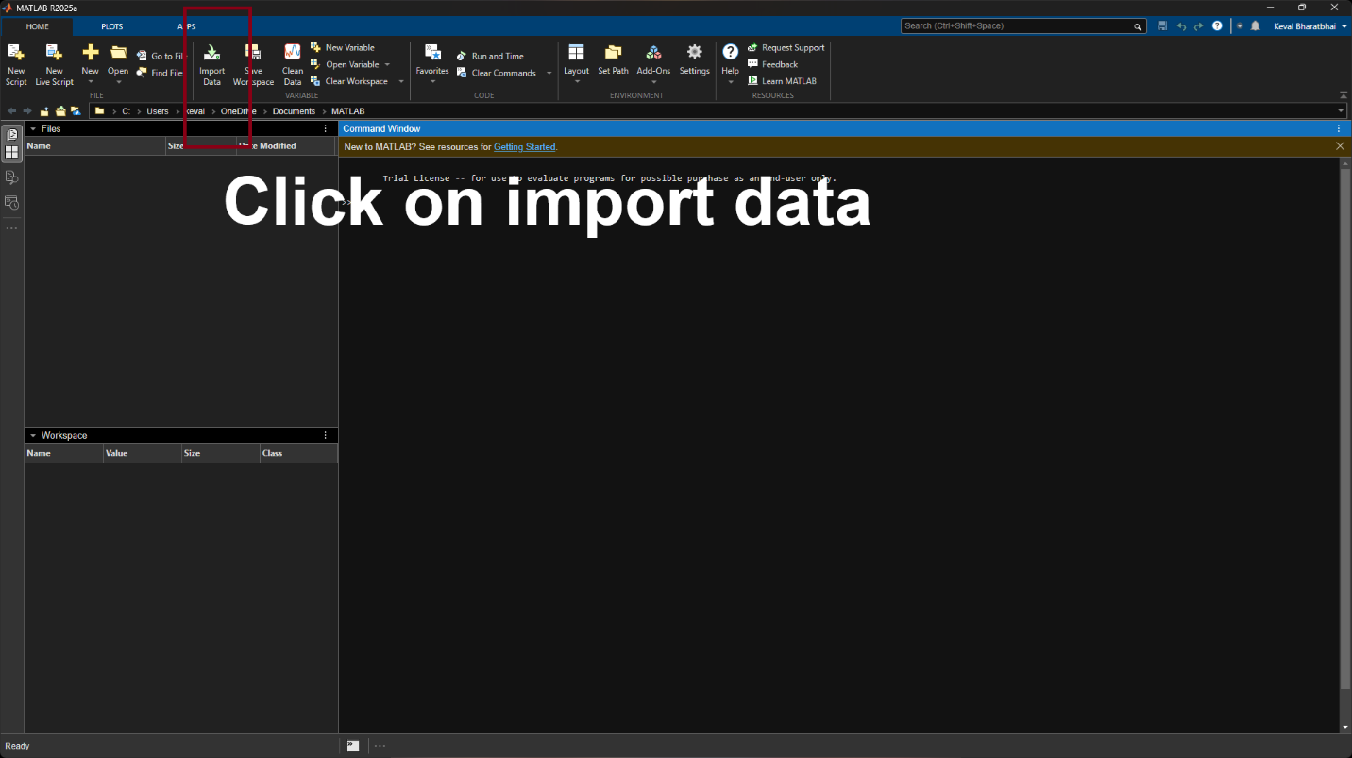
Import the data (i.e. CSV file)

Slide 6
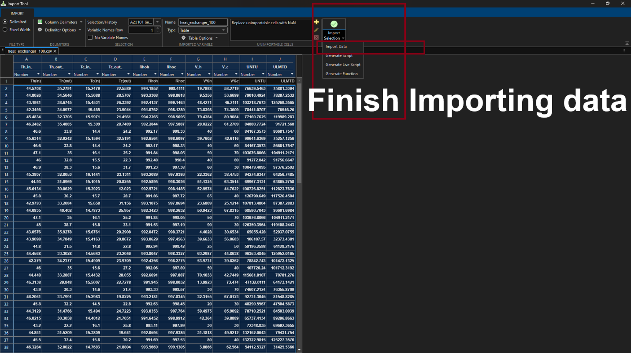
Import the data (i.e. CSV file) cont.

Slide 7
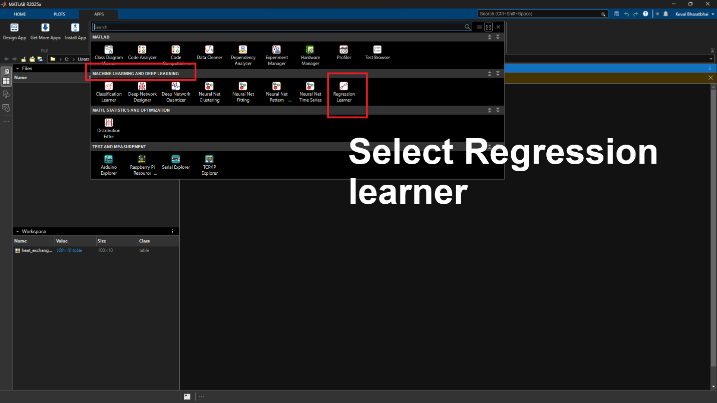
Getting to Regression Learner of Matlab

Slide 8
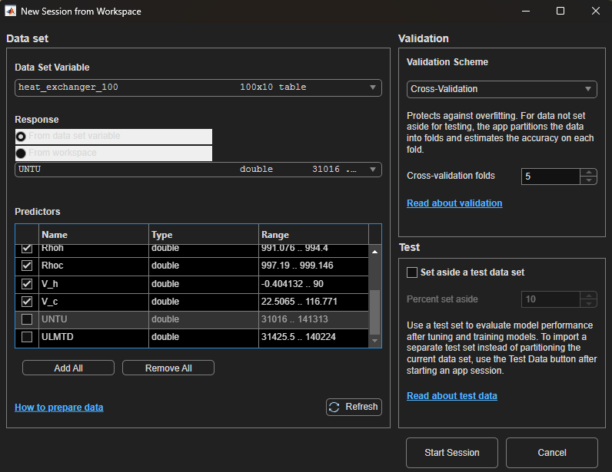
Select the input variables and the output you
wish to predict (either UNTU or ULMTD).
Keep Cross-Validation folds to default value of 5.
At this stage, we decide the division between training and testing. At the right bottom, select “Percent Set aside” as 20 or any other value you wish.
Make sure to uncheck U_{NTU} and U_{LMTD} as predictors.

Slide 9
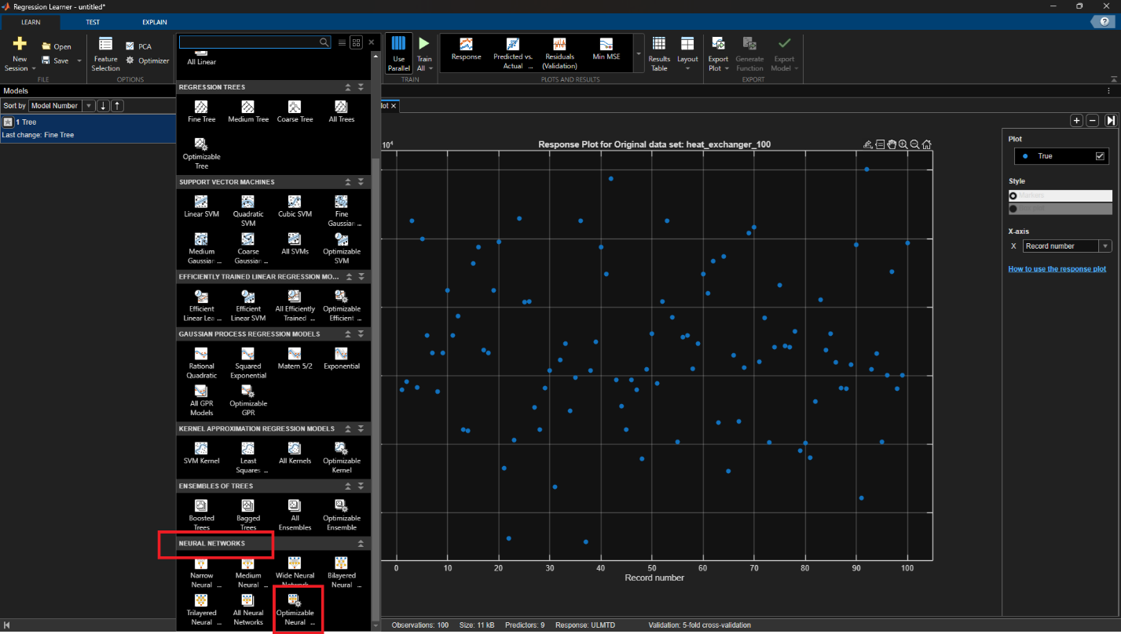
Select the Neural Network

Slide 10
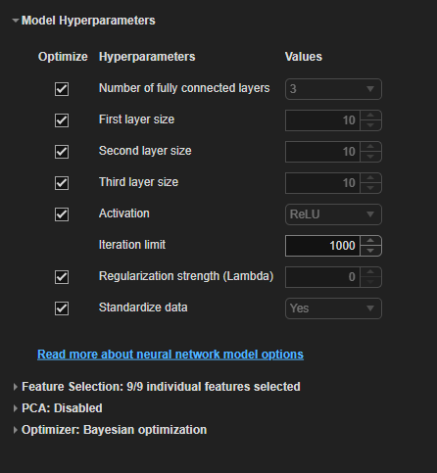
Changing HyperParameters

Slide 11
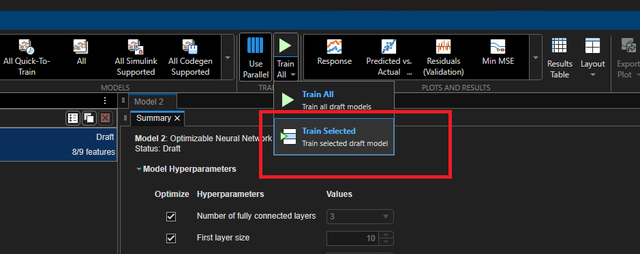
Training the model

Slide 12
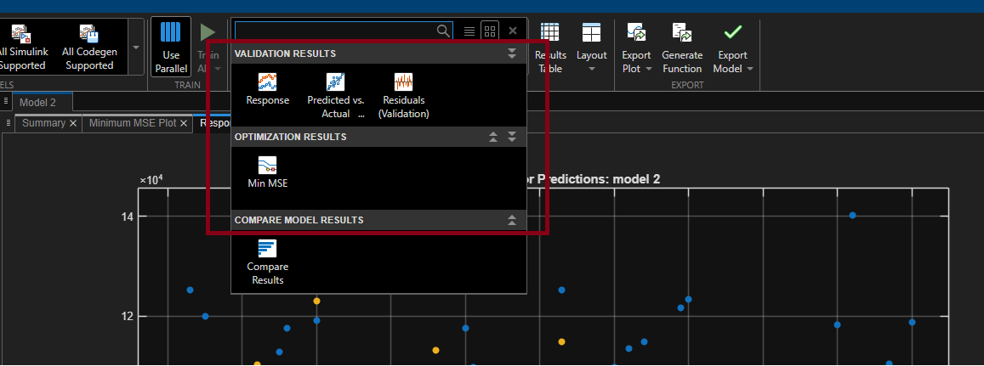
Save the validation and
optimization results

Slide 13
Summary
Aspect | Python + TensorFlow | MATLAB ML Toolbox
Code Length | ~20 lines of detailed code | ~8 lines with automation
Data Splitting | Manual train_test_split() | Automatic ValidationFraction
Feature Scaling | Manual StandardScaler() | Automatic 'Standardize', true
Model Training | Manual compile() + fit() | Single click model training
Flexibility | Full control over parameters | Limited but sufficient options
Learning Curve | Steeper, more concepts | Gentler, GUI available
Visualization | matplotlib/seaborn required | Built-in plots available

